Slide 1


CMPE 180-92 Data Structures and Algorithms in C++ November 2 Class Meeting
Department of Computer Engineering San Jose State University Fall 2017 Instructor: Ron Mak
www.cs.sjsu.edu/~mak

Slide 2
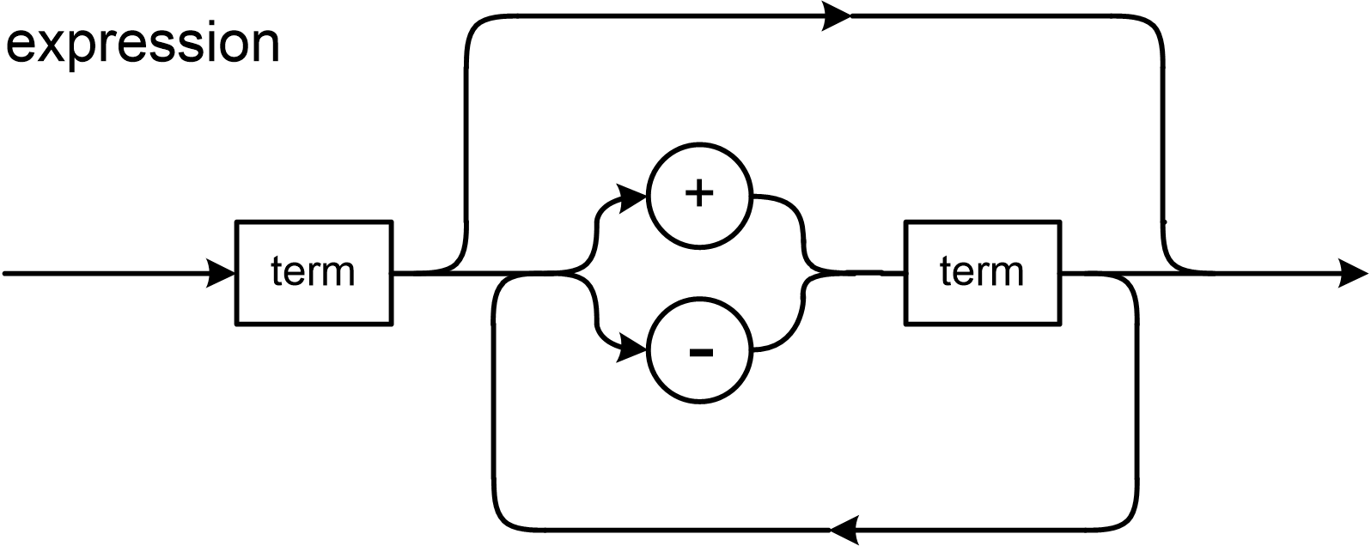
Assignment #10 Sample Solution
double Calculator::expression() const throw(string)
{
double value = term(); // evaluate the first term
bool done = false;
char ch;
do
{
cin >> ws;
ch = cin.peek();
switch (ch)
{
case '+':
{
cin >> ch; // read the +
value += term(); // evaluate the next term and add its value
break;
}
case '-':
{
cin >> ch; // read the -
value -= term(); // evaluate the next term and subtract its value
break;
}
default: done = true; // no more terms
}
} while (!done);
return value; // the expression's value
}

Slide 3
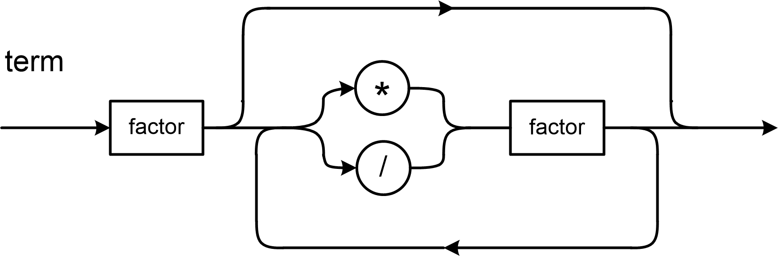
Assignment #10 Sample Solution, cont’d
double Calculator::term() const throw(string)
{
double value = factor(); // evaluate the first factor
bool done = false;
char ch;
do
{
cin >> ws;
ch = cin.peek();
switch (ch)
{
case '*':
{
cin >> ch; // read the *
value *= factor(); // evaluate the next factor and multiply its value
break;
}
case '/':
{
cin >> ch; // read the /
double value2 = factor(); // evaluate the next factor
// Do the division unless the value is zero.
if (value2 != 0) value /= value2;
else
{
throw string("Division by zero");
return 0;
}
break;
}
default: done = true; // no more factors
}
} while (!done);
return value; // the term's value
}

Slide 4
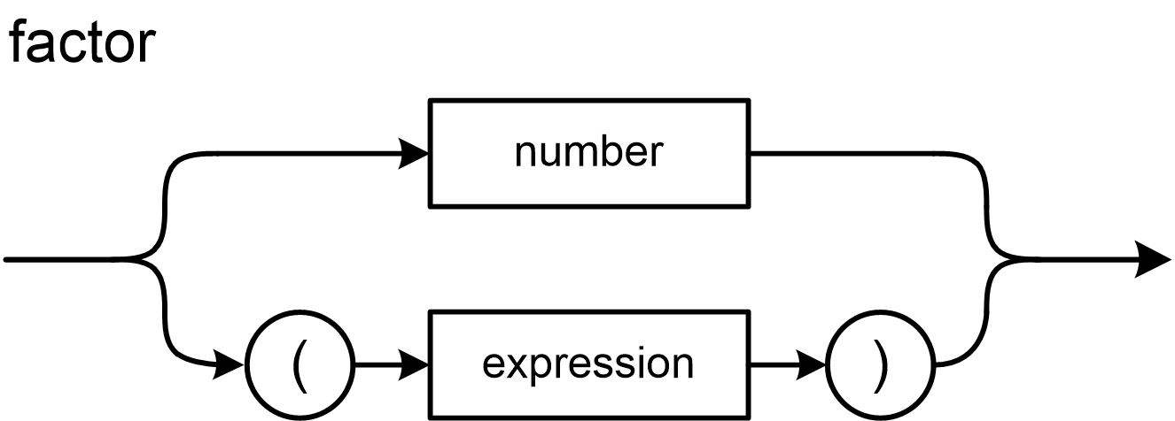
Assignment #10 Sample Solution, cont’d
double Calculator::factor() const throw(string)
{
cin >> ws; // skip blanks
char ch = cin.peek(); // what's the next input character?
if (isdigit(ch))
{
return number(); // evaluate and return a number's value
}
else if (ch == '(')
{
cin >> ch; // read the (
double value = expression(); // evaluate the subexpression
ch = cin.peek();
if (ch == ')') cin >> ch; // read the )
else
{
throw string("Missing )");
}
return value; // return the parenthesized subexpression's value
}
else
{
throw string("Invalid factor");
return 0;
}
}

Slide 5
Assignment #10 Sample Solution, cont’d
double Calculator::number() const throw(string)
{
double value;
cin >> value; // let >> read and evaluate the number
return value;
}

Slide 6
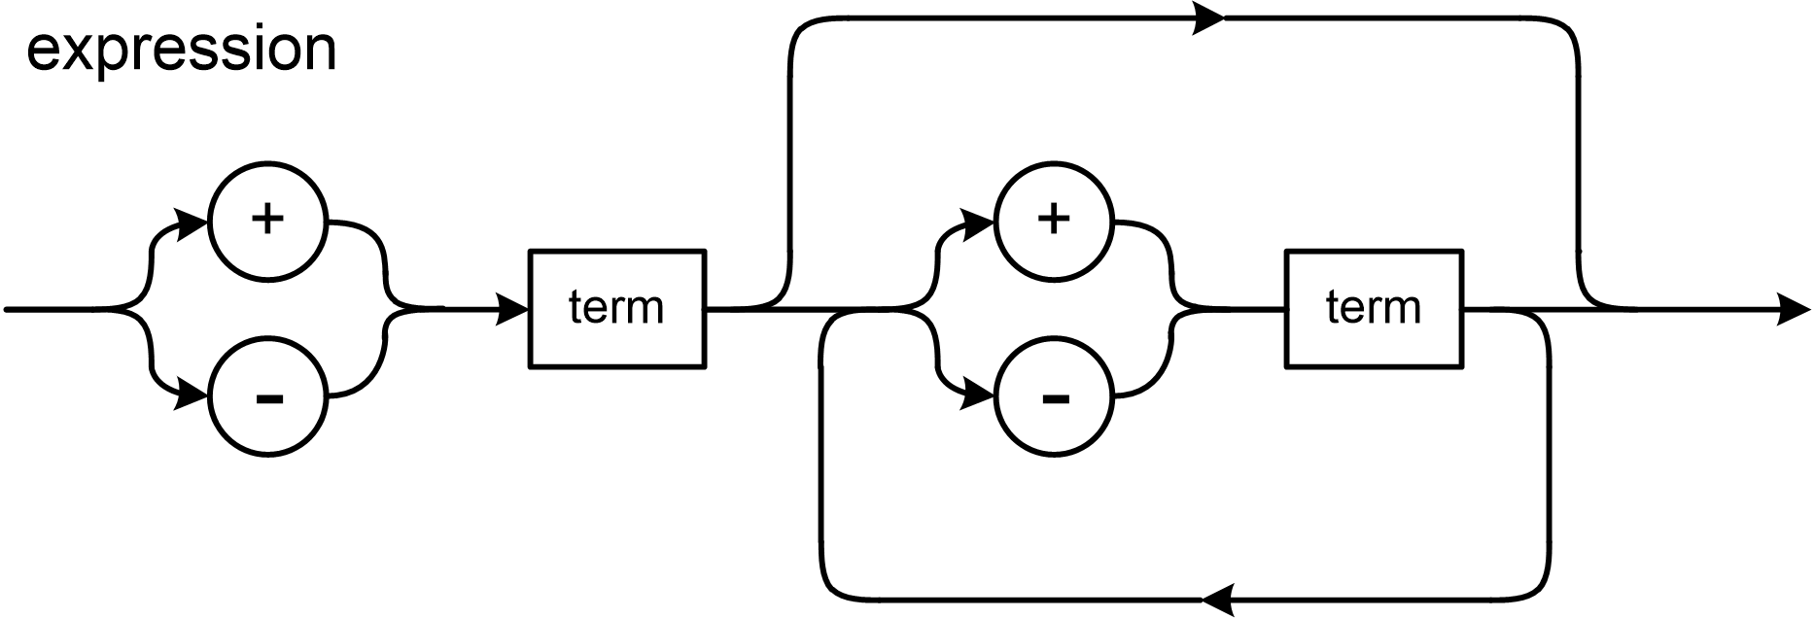
Assignment #10 Extra Credit
A leading + or – sign.

Slide 7
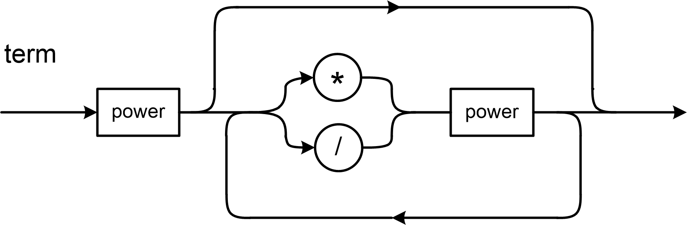
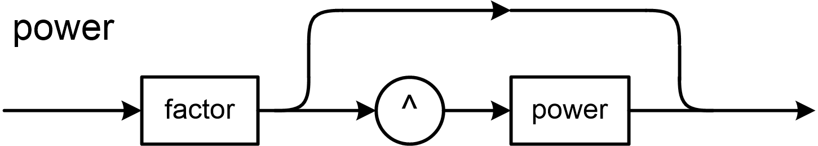
Assignment #10 Extra Credit, cont’d
Exponentiation

Slide 8
Introduction to Algorithm Analysis
To analyze an algorithm, we measure it.
A convenient measure must be:
A resource we care about (elapsed time, memory usage, etc.).
Quantitative, to make comparisons possible.
Easy to compute.
A good predictor of the “goodness” of the algorithm.
In this class, we will be concerned mostly with elapsed time.

Slide 9
Introduction to Algorithm Analysis, cont’d
Our concern generally is not how long a particular run of an algorithm will take, but how well the algorithm scales.
How does the run time increase as the amount of input increases?
Example: How does the reading time of a book increase as the number of pages increases?
Example: How does the run time of a particular sort algorithm increase as the number of items to be sorted increases?

Slide 10
Example: Reading Books
Algorithm: Read a book.
Measure: Length of time to read a book.
Given a set of books to read, can we predict how long it will take to read each one, without actually reading it?
Possible ways to compute reading time:
weight of the book
physical size (width, height, thickness) of the book
total number of words
total number of pages

Slide 11
Introduction to Algorithm Analysis, cont’d
When we compare two algorithms, we want to compare how well they scale.
How do their elapsed run times grow as the size of the input grows?
How do their growth rates compare?
Can we do this comparison without actually running the algorithms?
Some algorithms may be too expensive to run.

Slide 12
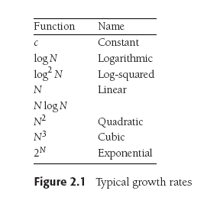
How Well Does an Algorithm Scale?
Data Structures and Algorithms in Java, 3rd ed.
by Mark Allen Weiss
Pearson Education, Inc., 2012
ISBN 978-0-13-257627-7

Slide 13
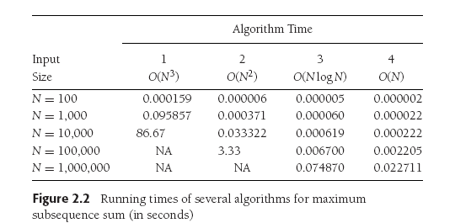
How Well Does an Algorithm Scale? cont’d
Data Structures and Algorithms in Java, 3rd ed.
by Mark Allen Weiss
Pearson Education, Inc., 2012
ISBN 978-0-13-257627-7

Slide 14
How Well Does an Algorithm Scale? cont’d
Data Structures and Algorithms in Java, 3rd ed.
by Mark Allen Weiss
Pearson Education, Inc., 2012
ISBN 978-0-13-257627-7

Slide 15
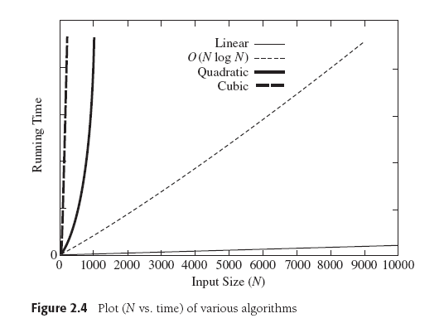
How Well Does an Algorithm Scale? cont’d
Data Structures and Algorithms in Java, 3rd ed.
by Mark Allen Weiss
Pearson Education, Inc., 2012
ISBN 978-0-13-257627-7

Slide 16
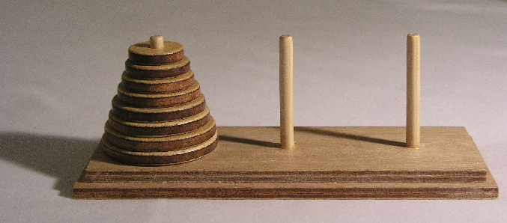
Towers of Hanoi
Goal: Move the stack of disks from the source pin to the destination pin.
You can move only one disk at a time.
You cannot put a larger disk on top of a smaller disk.
Use the third pin for temporary disk storage.

Slide 17
Towers of Hanoi, cont’d
Label the pins A, B, and C. Initial roles:
A: source
B: destination
C: temporary
Base case: n = 1 disk
Move disk from A to B (source ➔ destination)
Simpler but similar case: n-1 disks
Solve for n-1 disks: A to C (source ➔ temp)
Move 1 disk from A to B (source ➔ destination)
Solve for n-1 disks: C to B (temp ➔ destination)
During recursive calls, the pins
will assume different roles.

Slide 18
Towers of Hanoi: Analysis
How can we measure how long it will take to solve the puzzle for n disks?
What’s a good predictor?
The number times we move a disk from one pin to another.
Therefore, let’s count the number of moves.

Slide 19
Towers of Hanoi: Analysis, cont’d
Solve n disks
Solve for n-1 disks (source ➔ temp)
Move 1 disk (source ➔ destination)
Solve for n-1 disks (temp ➔ destination)
What is the pattern in the number of moves as n increases?
Let f(n) be the number of moves for n disks.
{
1 n = 1
2f(n-1) + 1 n > 1
f(n) =

Slide 20
Towers of Hanoi: Analysis
{
1 n = 1
2f(n-1) + 1 n > 1
f(n) =
This is a recurrence relation.
f shows up in its own definition: f(n) = 2f(n-1) + 1
The mathematical analogy of recursion.
Can we find the definition of function f ?
Observation: Since f(n) = 2f(n-1) + 1, we know that f(n) > 2f(n-1).
Therefore, if we increase the number of disks from n to n+1, the number of moves will at least double.

Slide 21
Towers of Hanoi: Count Moves
int main()
{
cout << "Disks Moves" << endl;
for (int n = 1; n <= 10; n++) {
int count = 0;
solve(n, Pin::A, Pin::B, Pin::C, count);
cout << setw(5) << n << setw(5) << count << endl;
}
}
void move(Pin from, Pin to, int& count)
{
count++;
}
Hanoi2.cpp
Don’t print. Just count moves.
Demo

Slide 22
Towers of Hanoi: Analysis
Disks Moves
1 1
2 3
3 7
4 15
5 31
6 63
7 127
8 255
9 511
10 1023
What’s the pattern?
Can we prove this?
Just because this formula holds for the first 10 values of n, does it hold for all values of n ≥ 1?
f(n) = 2^{n} - 1

Slide 23
Proof by Induction: Base Case
Prove that if:
then:
{
1 n = 1
2f(n-1) + 1 n > 1
f(n) = 2^{n} - 1
for all n ≥ 1
f(n) =
Let n = 1.
Then f(1) = 2¹ - 1 = 1 is true.

Slide 24
Proof by Induction: Inductive Step
Prove that if:
then:
{
1 n = 1
2f(n-1) + 1 n > 1
f(n) = 2^{n} - 1
for all n ≥ 1
f(n) =
Let n > 1.
Inductive hypothesis: Assume that f(k) = 2^{k} - 1 is true for all k < n, where n > 1
Since n-1 < n, then by our hypothesis: f(n-1) = 2^{n-1} – 1.
From the recurrence relation: f(n) = 2f(n-1) + 1 = 2(2^{n-1} - 1) + 1 = 2^{n} -1.
So f(n) = 2^{n} -1 for all n > 1.
Therefore, if f(k) = 2^{k} - 1 is true for all k < n, it must also be true for n as well.

Slide 25
Proof by Induction: What Happened?
Prove that if:
then:
{
1 n = 1
2f(n-1) + 1 n > 1
f(n) = 2^{n} - 1
for all n ≥ 1
f(n) =
First we proved it for n = 1 (the base case).
Then we proved that if it’s true for all k < n, where n > 1 (the induction hypothesis) then it must also be true for n.
Suppose n = 2. Since we know it’s true for n = 1 (the base case), it must be true for n = 2 (from above).
Suppose n = 3. Since we know it’s true for n = 2 (from above), it must be true for n = 3.
Etc.!

Slide 26
Another Proof By Induction Example
Observe that:
Prove:
1 = 1²
1 + 3 = 4 = 2²
1 + 3 + 5 = 9 = 3²
1 + 3 + 5 + 7 = 16 = 4²
… ?
1 + 3 + 5 + 7 + … + (2n -1) = n² for all n > 0
Base case:
Let n = 1. Then 1 = 1² is obviously true.
Induction hypothesis: Assume that 1 + 3 + 5 + 7 + … + (2k -1) = k² for some k > 0
Then show that: 1 + 3 + 5 + 7 + … + (2(k + 1) -1) = (k + 1)²
1 + 3 + 5 + 7 + …………… + (2(k + 1) -1) =
1 + 3 + 5 + 7 + … + (2k -1) + (2(k + 1) -1) =
k² + (2(k + 1) -1) = k² + 2k + 1
= (k + 1)²
True for n = 1.
If true for n = k
then true for n = k+1.

Slide 27
Algorithm Analysis
An algorithm is a set of operations to perform in order to solve a problem.
We want to know how an algorithm scales as its input size grows.
If T(N) is the running time of an algorithm with N input values, then how does T(N) change as N increases?

Slide 28
Big-Oh and its Cousins
Let T(N) be the running time of an algorithm with N input values.
Big-Oh
T(N) = O(f(N)) if there are positive constants c and n₀ such that T(N) ≤ cf(N) when N ≥ n₀.
In other words, when N is sufficiently large, function f(N) is an upper bound for time function T(N).
We don’t care about small values of N.
T(N) will grow no faster than f(N) as N increases.

Slide 29
Big-Oh and its Cousins, cont’d
Let T(N) be the running time of an algorithm with N input values.
Omega
T(N) = Ω(g(N)) if there are positive constants c and n₀ such that T(N) ≥ cg(N) when N ≥ n₀.
In other words, when N is sufficiently large, function g(N) is lower bound for time function T(N).
We don’t care about small values of N.
T(N) will grow at least as fast as g(N) as N increases.

Slide 30
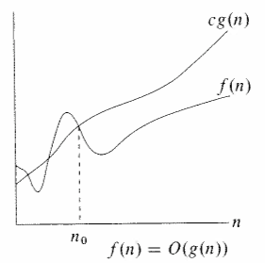
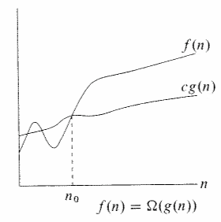
Big-Oh and its Cousins, cont’d
cf(N)
T(N)
T(N)
cg(N)
N
N
T(N) = O(f(N))
T(N) = Ω(g(N))
Upper bound
Lower bound

Slide 31
Big-Oh and its Cousins, cont’d
Let T(N) be the running time of an algorithm with N input values.
Theta
T(N) = Θ(h(N)) if and only if:
T(N) = O(h(N)) and
T(N) = Ω(h(N))
In other words, the rate of growth of T(N) equals the rate of growth of h(N).

Slide 32
Big-Oh and its Cousins, cont’d
Let T(N) be the running time of an algorithm with N input values.
Little-Oh
T(N) = o(p(N)) if there are positive constants c and n₀ such that T(N) < cp(N) when N ≥ n₀.
p(N) is similar to the upper bound function f(N) but instead of T(N) ≤ cf(N) we have T(N) < cp(N).

Slide 33
Big-Oh and its Cousins, cont’d
If T₁(N) = O(f₁(N)) and T₂(N) = O(f₂(N)) then
T₁(N) + T₂(N) = O(f₁(N) + f₂(N)) or O(max(f₁(N), f₂(N)))
T₁(N) x T₂(N) = O(f₁(N) x f₂(N))
If T(N) is a polynomial of degree k, then
T(N) = Θ(N^{k})
If T(N) = log^{k} N for any constant k, then
T(N) = O(N)
Logarithms grow slowly!

Slide 34
Quiz
Canvas: Quiz 7 – 2017 Apr 13
20 minutes

Slide 35
Break

Slide 36
Towers of Hanoi: Rate of Growth
We decided that a good predictor of T(n) for solving the Towers of Hanoi problem was f(n).
n is the number of disks
f(n) = 2^{n}-1 is the number of disk moves
Therefore,
T(n) = Θ(2^{n})

Slide 37
Compare Growth Rates
If we want to compare the growth rates of two functions f(N) and g(N), compute
The limit is 0: f(N) = o(g(N)) g(N) is an upper bound for f(N).
The limit is a constant c ≠ 0: f(N) = Θ(g(N)) f(N) and g(N) have the same growth rate.
The limit is ∞: g(N) = o(f(N)) f(N) is an upper bound for g(N).
lim f(N) / g(N) N→∞

Slide 38
General Rules for Computing Running Time
Consecutive statements
Add the running times of the statements.
Generally, only consider the statement with the maximum running time.
Branching statement
The running time of the entire statement is at most the maximum running time of its branches.

Slide 39
Computing Running Time, cont’d
Loop
The running time of a loop is at most the number of iterations times the running time of the statements in the loop.
Nested loops
Compute the running time of the statements in the innermost loop, then multiply by the product of the numbers of iterations of all the loops.

Slide 40
Scalability of Different Algorithms
Problem: Compute the n^{th} Fibonacci number.
Two algorithms to solve this problem:
Start with 1, 1, and repeatedly add the previous two values.
LinearGrowthRate: T(N) = O(N)
Use recursion: fib(n) = fib(n-2) + fib(n-1)
ExponentialGrowthRate: T(N) = Ω(1.5^{N})
Why is the growth
rate exponential?

Slide 41
Scalability of Different Algorithms, cont’d
One set of results for the Fibonacci problem.
Times in milliseconds.
n Linear Exponential
5 0 0
10 0 1
15 0 0
20 0 2
25 0 3
30 0 4
35 0 45
40 0 504
45 0 5358
50 0 59267

Slide 42
Hash Tables
Consider an array or a vector.
To access a value, you use an integer index.
The array “maps” the index to a data value stored in the array.
The mapping function is very efficient.
As long as the index value is within range, there is a strict one-to-one correspondence between an index value and a stored data value.
We can consider the index value to be the “key” to the corresponding data value.

Slide 43
Hash Tables, cont’d
A hash table also stores data values.
Use a key to obtain the corresponding data value.
The key does not have to be an integer value.
For example, the key could be a string.
There might not be a one-to-one correspondence between keys and data values.
The mapping function might not be trivial.

Slide 44
Hash Tables, cont’d
We can implement a hash table as an array of cells.
Refer to its size as TableSize.
If the hash table’s mapping function maps a key value into an integer value in the range 0 to TableSize – 1, then we can use this integer value as the index into the underlying array.

Slide 45
Hash Tables, cont’d
Suppose we’re storing employee data records into a hash table.
We use an employee’s name as the key.

Slide 46
Hash Tables, cont’d
Suppose that the name
john hashes (maps) to 3
phil hashes to 4
dave hashes to 6
mary hashes to 7
This is an ideal situation because each employee record ended up in a different table cell.
Data Structures and Algorithms in Java, 3rd ed.
by Mark Allen Weiss
Pearson Education, Inc., 2012
ISBN 0-13-257627-9

Slide 47
Hash Function
We need an ideal hash function to map each data record into a distinct table cell.
It can be very difficult to find such a hash function.

Slide 48
A Simple Hash Function
Suppose our keys are words and the table size is 10,007 (a prime number).
Problem: This hash function does not distribute the keys well if the table is large.
The maximum ASCII character value is 127.
If a typical word is 8 characters long, the hash function generally has values from 0 to 1,016.
int hash(const string& word, int table_size)
{
int hashVal = 0;
for (char ch : word) hashVal += ch;
return hashVal%table_size;
}

Slide 49
Another Simple Hash Function
int hash(const string& word, int table_size)
{
return (key[0] + 27*key[1] + 729*key[2])%table_size;
}
We use only the first three letters of each word.
27 letters in the alphabet + space
729 = 27²
Good distribution into a table of 10,007 if the first three letters are random.
But the English language is not random and many words will start with the same three letters.

Slide 50
A Better Hash Function
int hash(const string& word, int table_size)
{
unsigned int hashVal = 0;
for (char ch : word) hashVal = 37*hashVal + ch;
return hashVal%table_size;
}
Calculates a polynomial function by nested multiplication (Horner’s rule).
Easy and fast to calculate.
Distributes the keys well into a large table.

Slide 51
Collisions
The more data we put into a hash table, the more “collisions” occur.
A collision is when two or more data records are mapped to the same table cell.
How can a hash table handle collisions?

Slide 52
Keys for Successful Hashing
Good hash function
Good collision resolution
Size of the underlying array a prime number

Slide 53
Collision Resolution
Separate chaining
Open addressing
Linear probing
Quadratic probing

Slide 54
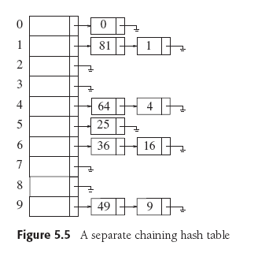
Collision Resolution: Separate Chaining
Each cell in a hash table is a pointer to a linked list of all the data records that hash to that entry.
To retrieve a data record, we first hash to the cell.
Data Structures and Algorithms in Java, 3rd ed.
by Mark Allen Weiss
Pearson Education, Inc., 2012
ISBN 0-13-257627-9

Slide 55
Collision Resolution: Separate Chaining, cont’d
Then we search the associated linked list for the data record.
We can sort the linked lists to improve search performance.
Data Structures and Algorithms in Java, 3rd ed.
by Mark Allen Weiss
Pearson Education, Inc., 2012
ISBN 0-13-257627-9

Slide 56
Collision Resolution: Open Addressing
Does not use linked lists.
All the data resides in the table.
When a collision occurs, try a different table cell.
We will consider two types of open addressing:
linear probing
quadratic probing

Slide 57
Collision Resolution: Linear Probing
Try in succession h₀(x), h₁(x), h₂(x), …
h_{i}(x) = (hash(x) + f(i)) mod TableSize, with f(0) = 0
hash(x) produces the home cell.
Function f is the collision resolution strategy.
With linear probing, f is a linear function of i, typically, f(i) = i

Slide 58
Collision Resolution: Linear Probing, cont’d
Insertion
If a cell is filled, look for the next empty cell.
Search
Start searching at the home cell, keep looking at the next cell until you find the matching key is found.
If you encounter an empty cell, there is no key match.
Deletion
Empty cells will prematurely terminate a search.
Leave deleted items in the hash table but mark them as deleted.

Slide 59
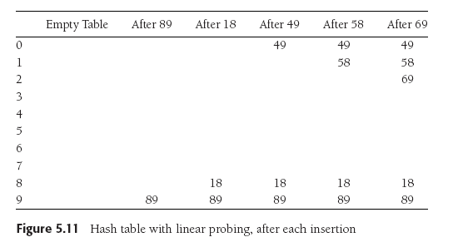
Collision Resolution: Linear Probing, cont’d
Suppose TableSize is 10, the keys are integer values, and the hash function is the key value modulo 10.
We want to insert keys 89, 18, 49, 58, and 69.
Data Structures and Algorithms in Java, 3rd ed.
by Mark Allen Weiss
Pearson Education, Inc., 2012
ISBN 0-13-257627-9

Slide 60
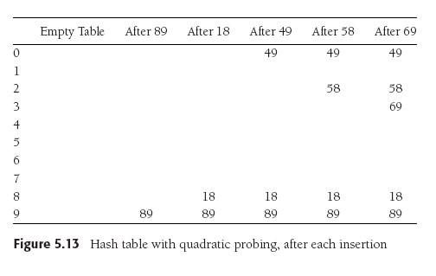
Collision Resolution: Quadratic Probing
Linear probing causes primary clustering.
Try quadratic probing instead: f(i) = i².
49 collides with 89: the next empty cell
is 1 away.
58 collides with 18: the next cell is filled.
Try 2² = 4 cells away
from the home cell.
Same for 69.
Data Structures and Algorithms in Java, 3rd ed.
by Mark Allen Weiss
Pearson Education, Inc., 2012
ISBN 0-13-257627-9

Slide 61
Collision Resolution: Quadratic Probing, cont’d
Try quadratic probing instead: f(i) = i².
i² is easy to compute, for i = 0, 1, 2, ...
Remember that we proved that
1 = 1²
1 + 3 = 4 = 2²
1 + 3 + 5 = 9 = 3²
1 + 3 + 5 + 7 = 16 = 4²
…

Slide 62
Load Factor
The load factor λ of a hash table is the ratio of the number of elements in the table to the table size.
λ is much more important than table size.
For probing collision resolution strategies, it is important to keep λ under 0.5.
Don’t let the table become more than half full.
If quadratic probing is used and the table size is a prime number, then a new element can always be inserted if the table is at most half full.

Slide 63
Assignment #11
Read a copy of the U.S. Constitution and its amendments, and build a concordance table.
Concordance: An alphabetical list of words in a text, each word with the number of times it appears.
Maintain the concordance in both a sorted STL vector and in an STL map (hash table).
Compare the timings of the vector and the map:
Insertion of words
Searching for words

